Slide 1
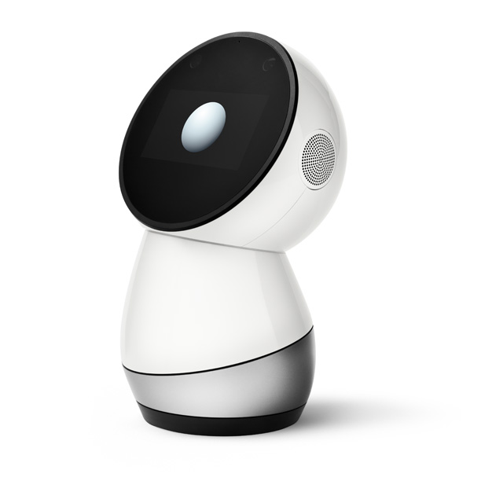
@jibodev

Slide 2


Slide 3
@jibodev

Slide 4

SDK.jibo.com
@jibodev

Slide 5
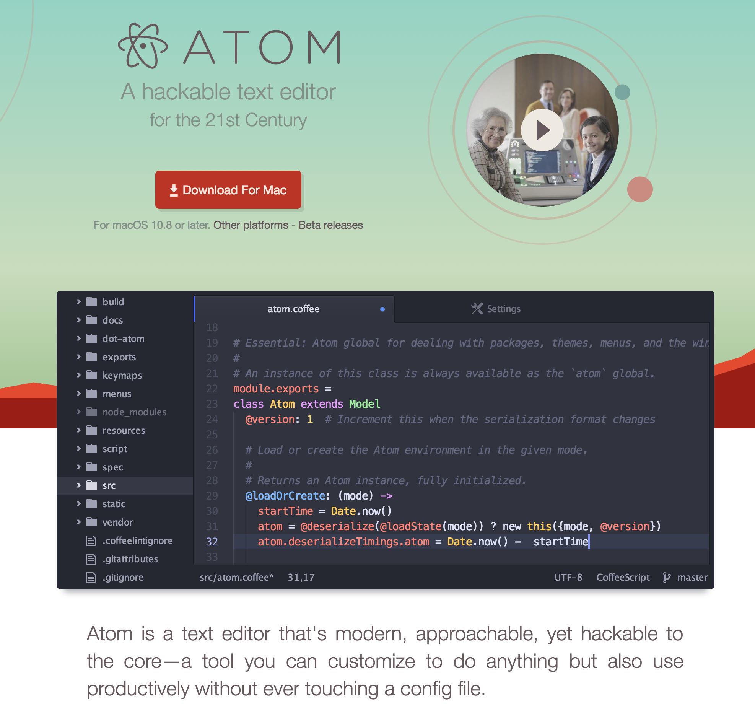
@jibodev

Slide 6
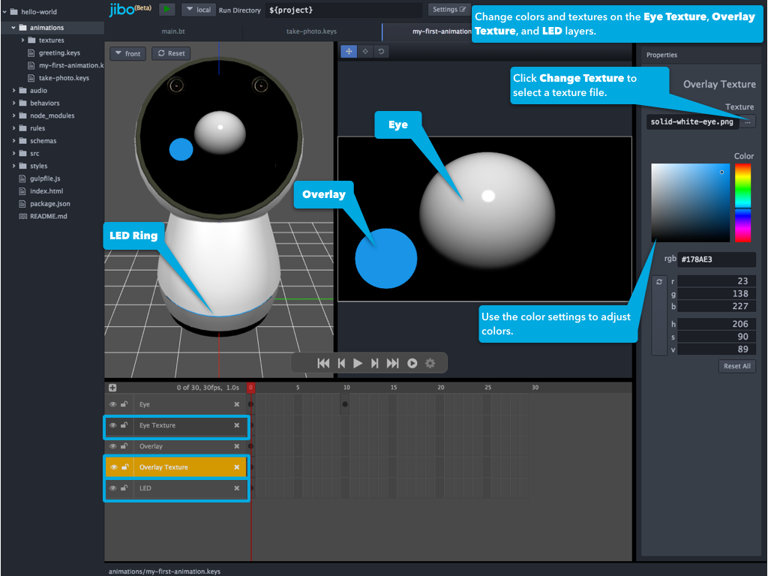
@jibodev

Slide 7
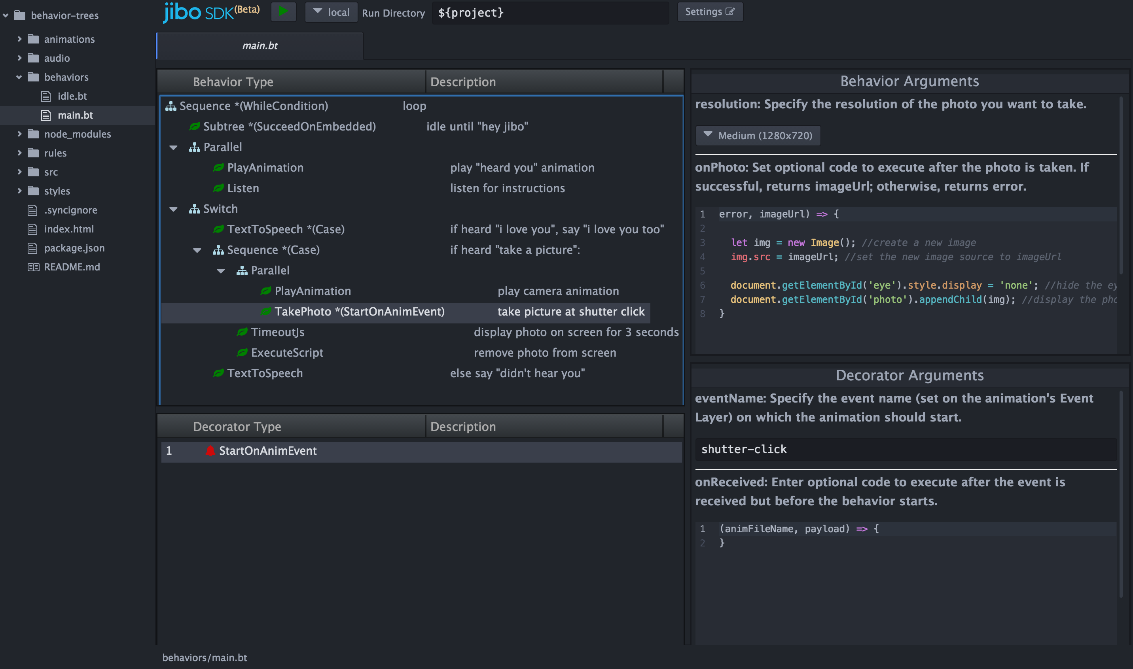
@jibodev

Slide 8
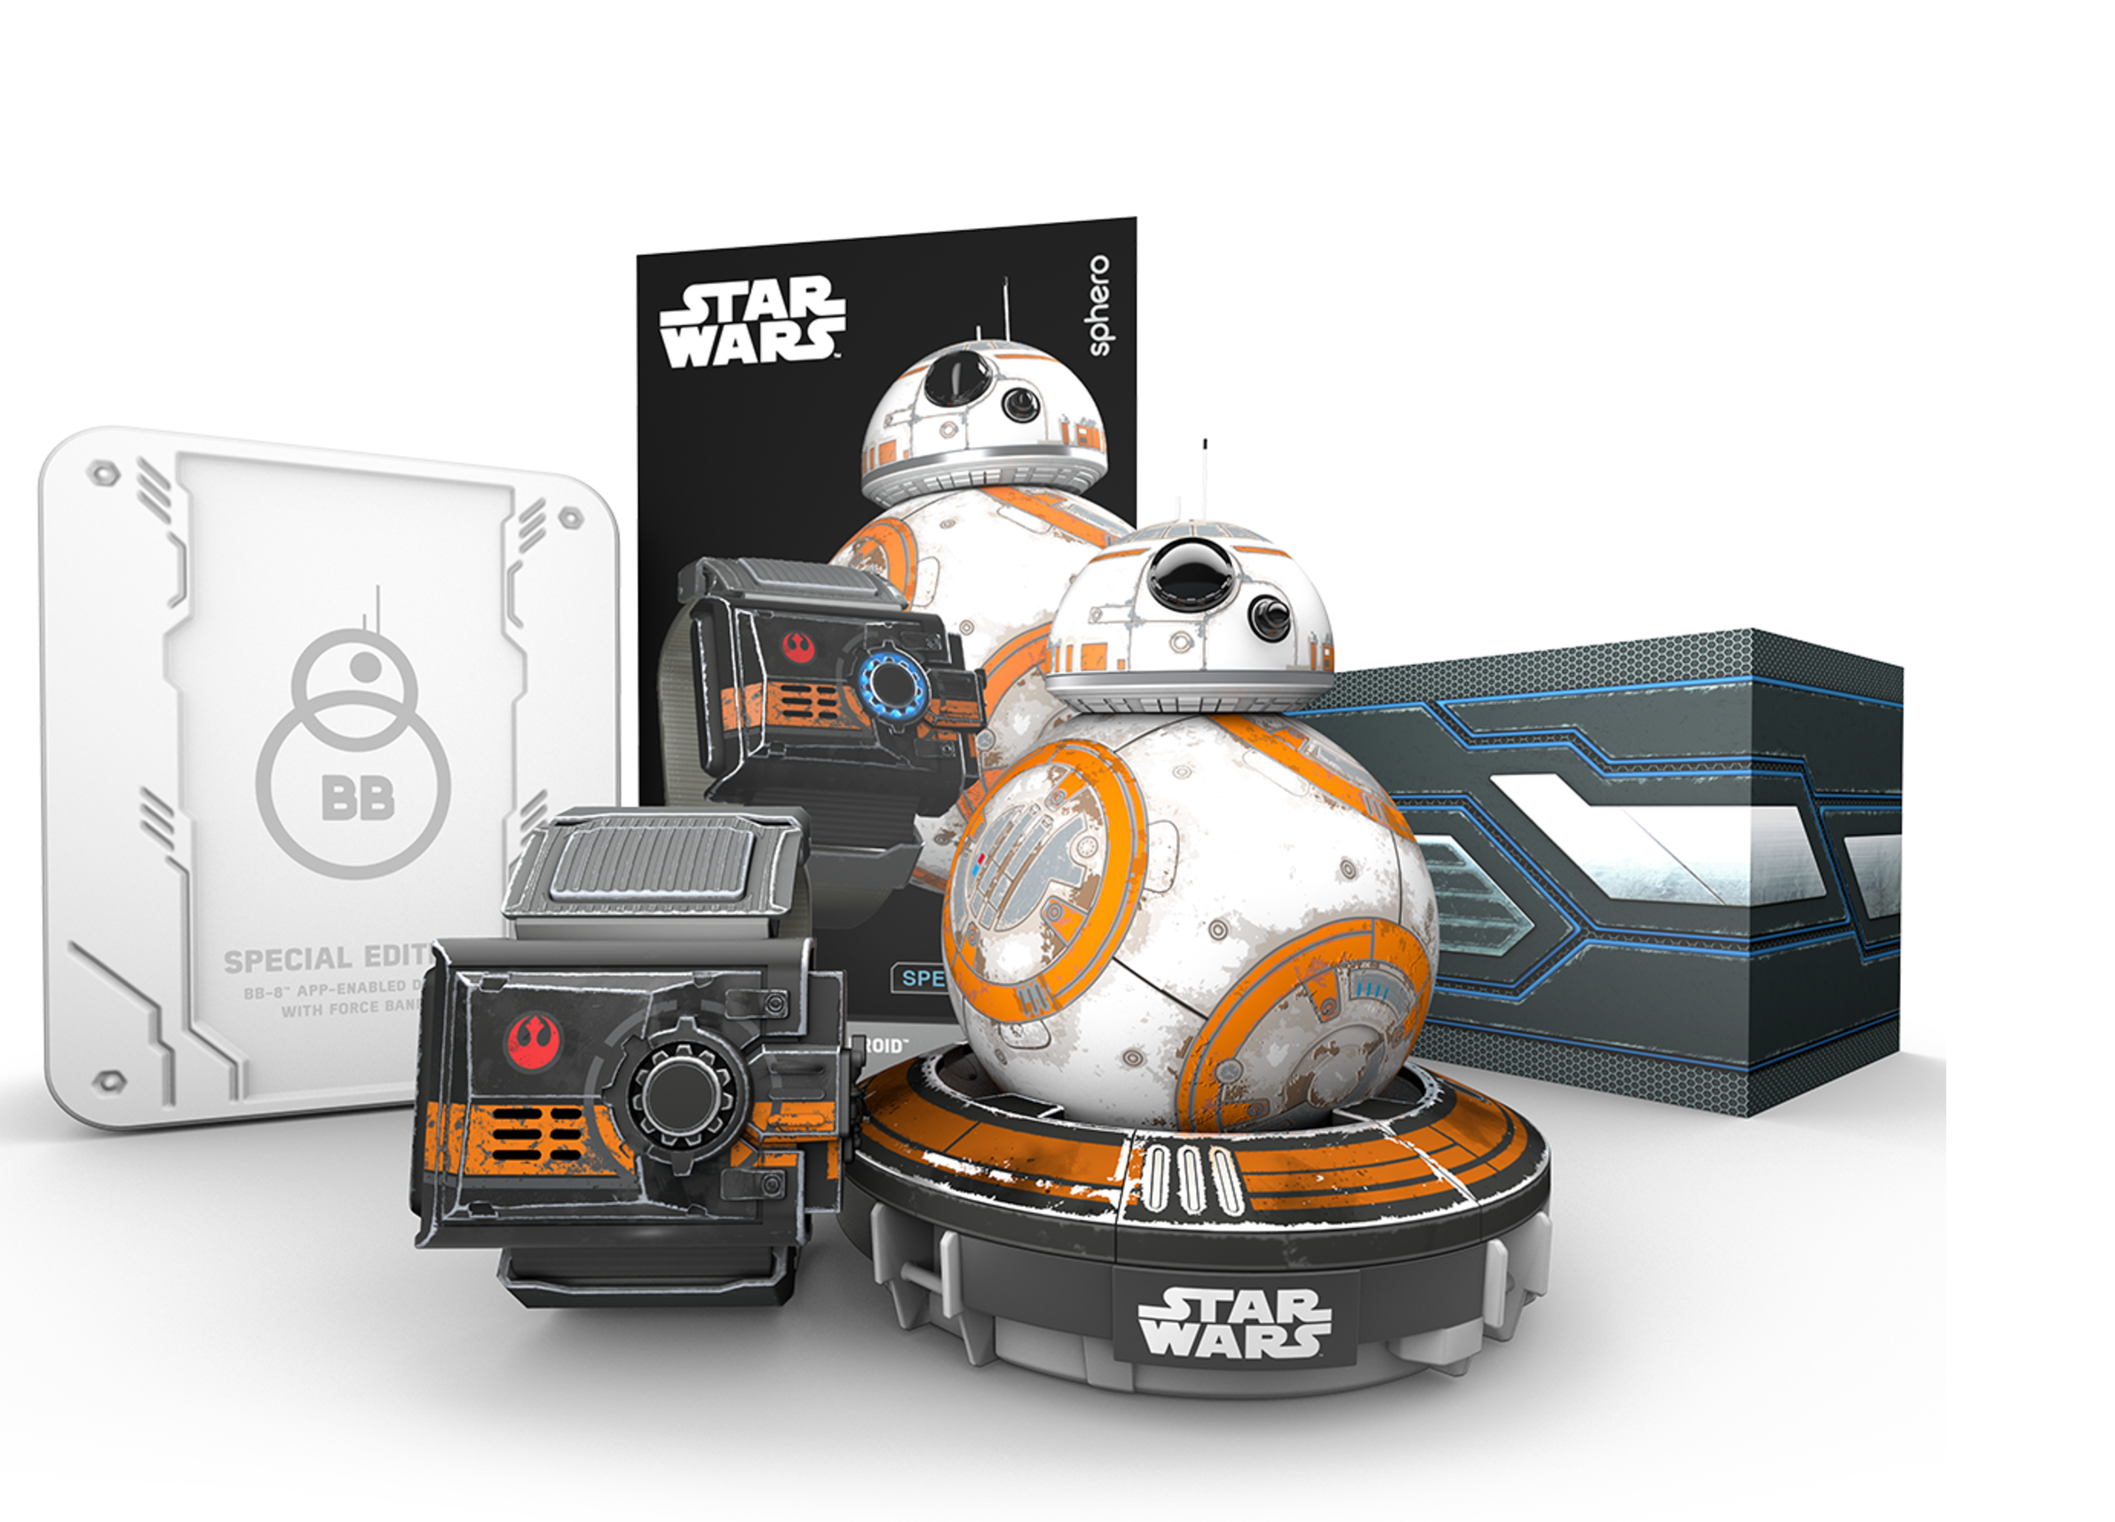
@jibodev

Slide 9
@jibodev

Slide 10
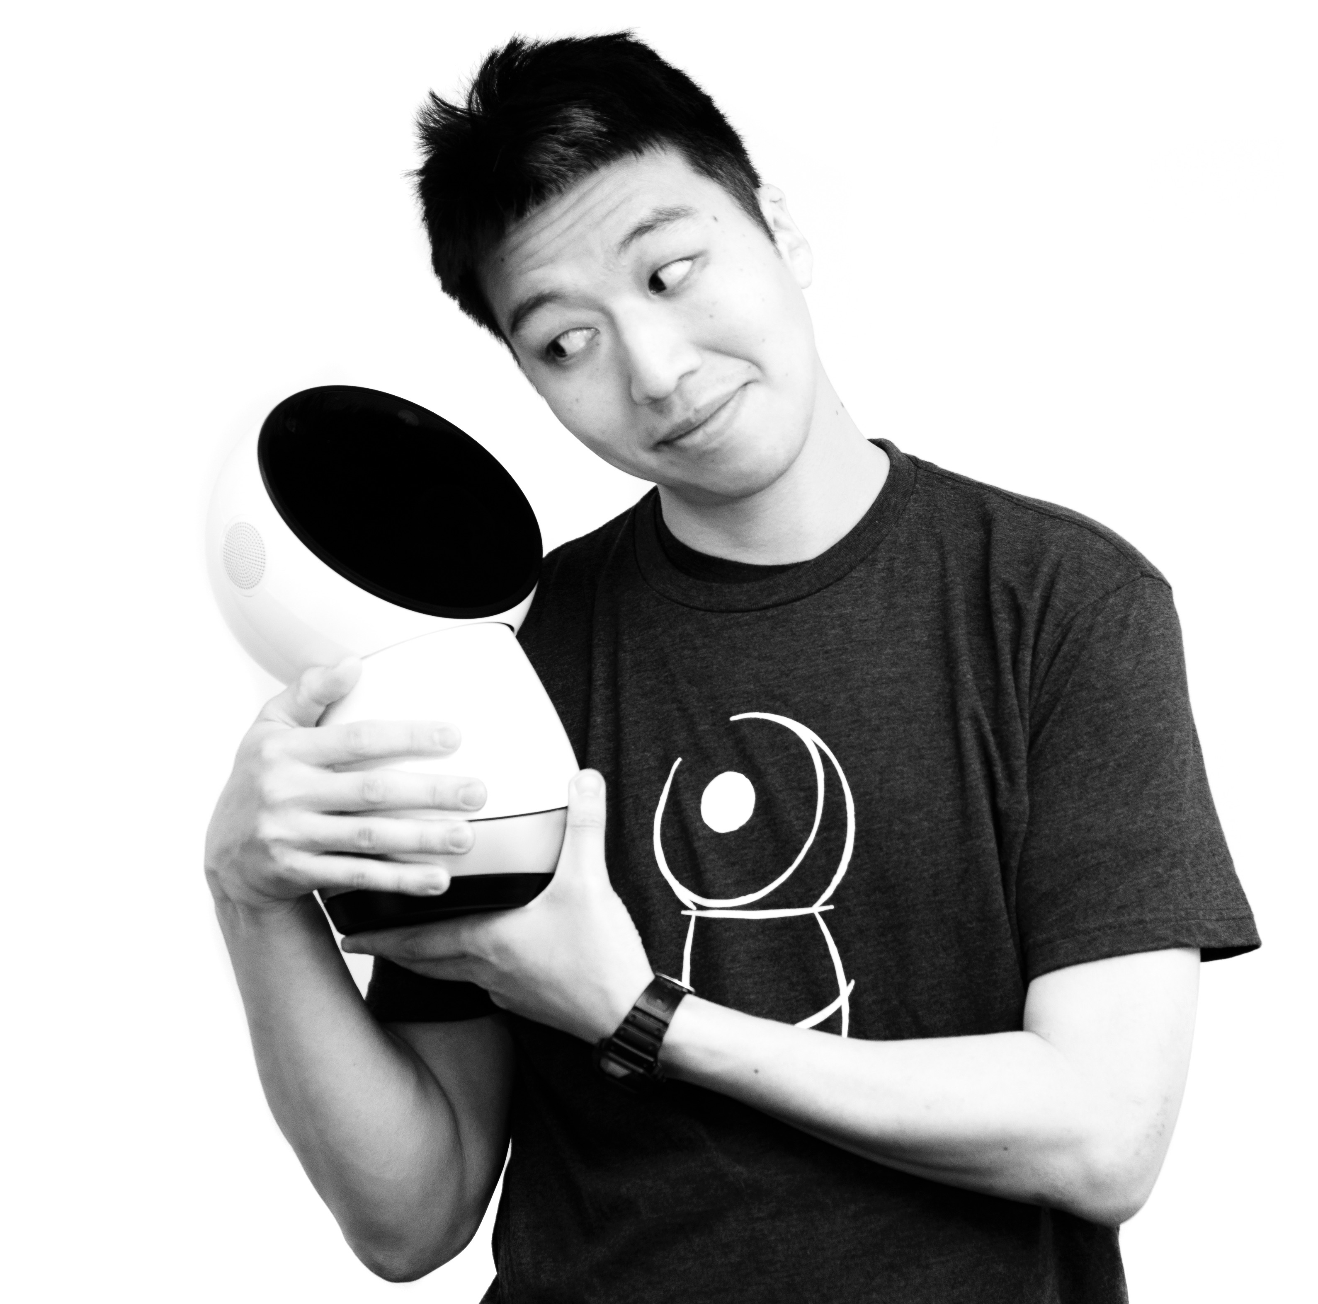

justin@jibo.com
Developer Evangelist
carolyn@jibo.com
Robot SDK Engineer
@jibodev

Slide 11
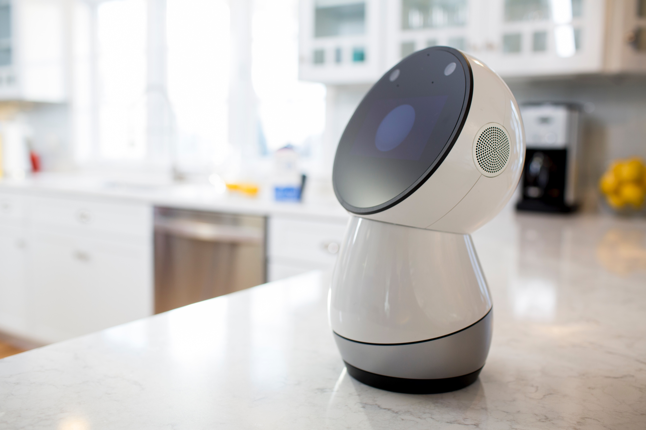
@jibodev

